Slide 1
Pytheas: Enabling Data-Driven Quality of Experience Optimization Using Group-Based Exploration-Exploitation
Junchen Jiang (CMU)
Shijie Sun (Tsinghua Univ.)
Vyas Sekar (CMU)
Hui Zhang (CMU, Conviva Inc.)

Slide 2
Key points in one minute…
Data-driven QoE optimization shows promising quality improvement …
Data-driven optimization should use real-time exploration-exploitation
How to make decisions with fresh data of geo-distributed sessions at scale
Pytheas: design & implementation of group-based exploration-exploitation

Slide 3
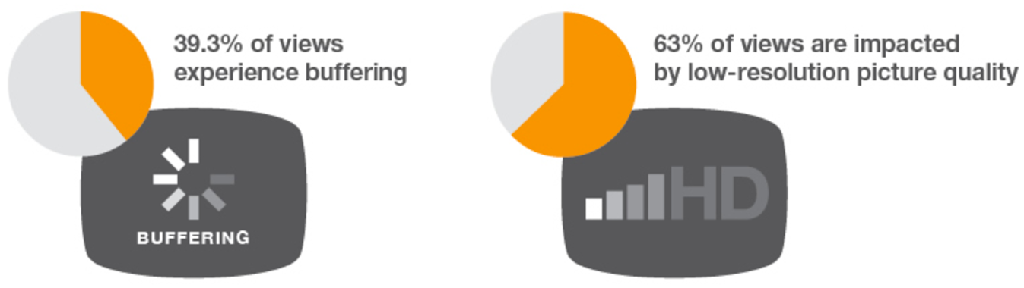

Quality of Experience (QoE) today is not ideal
[Source: Conviva]

Slide 4
Data-driven approach is promising
Global data of many devices
Local data of single device
Internet
CFA [NSDI’16]
Footprint [NSDI’16]
VIA [SIGCOMM’16]
CS2P [SIGCOMM’16]
C3 [NSDI’15]
SPAND [INFOCOM’00]
Internet
Classic approaches
Data-driven approach

Slide 5
Status quo: Prediction-based workflow
Data Collection
QoE Predictor
Which CDN and bitrate?
Internet

Slide 6
Limitations of prediction-based workflow
Data Collection
= F(Prior Decisions)
QoE Predictor
Limitation #1: Prediction bias
Less data on historically worse decisions
Which CDN and bitrate?
Internet
Limitation #2: Slow reaction
Predictions updated on coarse timescales

Slide 7
Outline
What’s the right abstraction?
Why it’s challenging?
How to implement it in network contexts?
Evaluation

Slide 8
Ideal abstraction: Real-time exploration-exploitation (Real time E2)
Real-time E2 logic
Decision making
Data Collection
Internet

Slide 9
Drawing a parallel from ML
Goal: Maximize mean rewards given a limited amount of pulls
Goal: Optimize mean QoE for a limited amount of sessions
Slot machines
Decision space
Reward
Reward
QoE
QoE
Pulls by a gambler
Sessions
…

Slide 10
Outline
What’s the right abstraction? ➔ Real-time E2
Why it’s challenging?
How to implement it in network contexts?
Evaluation

Slide 11
Challenge #1: Application sessions are different
Running E2 per geolocation?
Doesn’t capture complex factors
Real-time E2 logic
NYC
Comcast
iOS
NYC
Comcast
iOS
NYC
AT&T
Flash
NYC
AT&T
Flash
Chicago
Comcast
iOS
Chicago
Comcast
iOS
Chicago
AT&T
Flash
Chicago
AT&T
Flash

Slide 12
Challenge #2: E2 with fresh data of geodistributed sessions
Backend
Global but stale data
Backend
Running E2 in Backend?
Doesn’t have fresh data
Running E2 in Frontend?
Doesn’t have global data
Frontend
Fresh but local data
Frontend A
Frontend B

Slide 13
Outline
What’s the right abstraction? Real-time E2
Why it’s challenging? Applying E2 in networking contexts
How to implement it in network contexts?
Evaluation

Slide 14
Pytheas: Group-based E2
Backend
Running real-time E2 at a per-group granularity
Frontend A
Frontend B
NYC
Comcast
VoD
NYC
Comcast
Live
NYC
AT&T
Live
NYC
AT&T
Live
Chicago
Comcast
VoD
Chicago
Comcast
VoD
Chicago
AT&T
Live
Chicago
AT&T
VoD

Slide 15

Idea #1: Grouping sessions by Critical Features
City | ISP | Content
NYC | Comcast | VoD
F( )
$$≈$$
F( )
NYC | Comcast | *
Sessions in the same group share the best decision
Critical Features [NSDI’2016]: Subset of features ultimately determines video quality
NYC
Comcast
VoD
NYC
Comcast
Live
NYC
AT&T
Live
NYC
AT&T
Live
Chicago
Comcast
VoD
Chicago
Comcast
VoD
Chicago
AT&T
Live
Chicago
AT&T
VoD

Slide 16
Idea #1: Grouping sessions by Critical Features
Per-group E2 logic
Upper Confidence Bound algorithm
NYC
Comcast
VoD
NYC
Comcast
Live
NYC
AT&T
Live
NYC
AT&T
Live
Chicago
Comcast
VoD
Chicago
Comcast
VoD
Chicago
AT&T
Live
Chicago
AT&T
VoD

Slide 17
Idea #2: Per-group sessions share network locality
In 90+% of groups, the sessions are from the same ISP and city.
Per-group E2 logic
Upper Confidence Bound algorithm
Frontend A
Frontend B
Per-group E2 logic
(update w. fresh data)
NYC
Comcast
VoD
NYC
Comcast
Live
NYC
AT&T
Live
NYC
AT&T
Live
Chicago
Comcast
VoD
Chicago
Comcast
VoD
Chicago
AT&T
Live
Chicago
AT&T
VoD

Slide 18
Idea #3: Session grouping is persistent
Session-grouping logic
(updated per 10s min)
Backend
Frontend A
Frontend B
Per-group E2 logic
(update w. fresh data)
NYC
Comcast
VoD
NYC
Comcast
Live
NYC
AT&T
Live
NYC
AT&T
Live
Chicago
Comcast
VoD
Chicago
Comcast
VoD
Chicago
AT&T
Live
Chicago
AT&T
VoD

Slide 19
Pytheas implementation
History storage
Session-grouping logic
Backend
Publish/subscribe
Per-group logic
Frontend
Publish/subscribe
Client-facing servers
HTTP POST
Client
(e.g., video player)

Slide 20
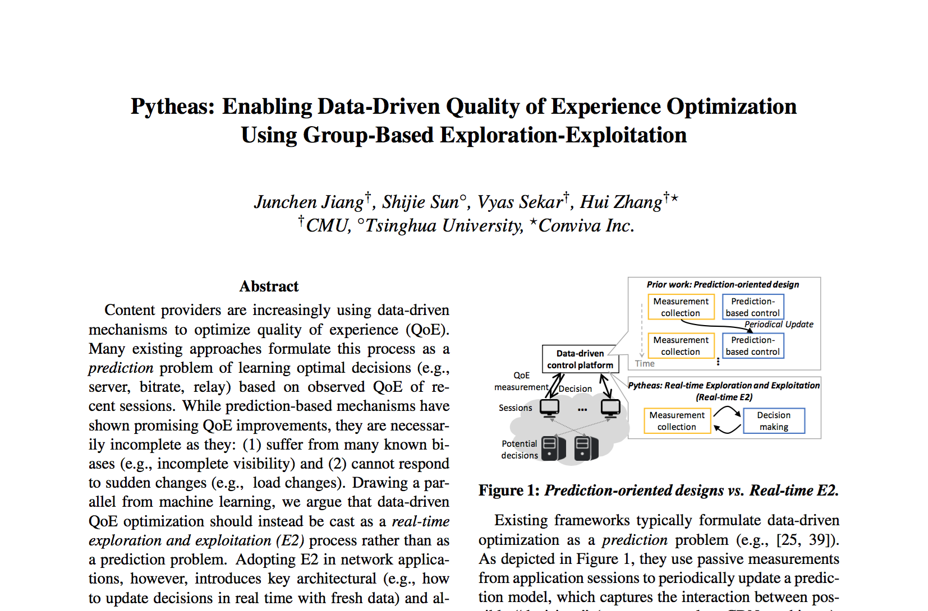
More in our paper
Cross-frontend E2
Fault tolerance
Pytheas API
Throughput optimization

Slide 21
Outline
What’s the right abstraction? Real-time E2
Why it’s challenging? Applying E2 in networking contexts
How to implement it in network contexts?
Pytheas (Group-based E2)
Evaluation

Slide 22
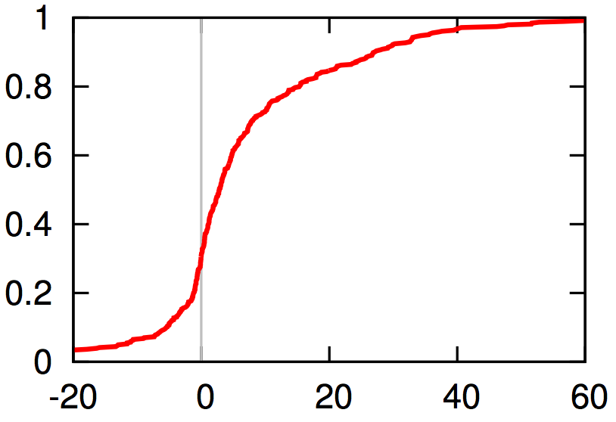
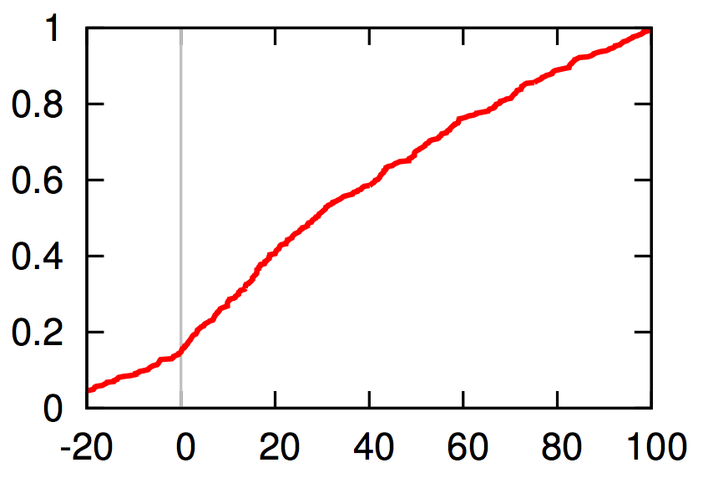
QoE improvement over a prediction-based baseline
Real-world trace:
8.5 million video sessions
Major content provider x 24hrs
Prediction-based baseline: CFA [NSDI 2016]
Join time
Buffering ratio
Better QoE:
Improve over CFA by 6-30% on mean, and up to 24-78% on 90th %ile
CDF
CDF
Pytheas better than CFA
Pytheas better than CFA
Reduction on join time over CFA (%)
Reduction on buffering ratio over CFA (%)

Slide 23
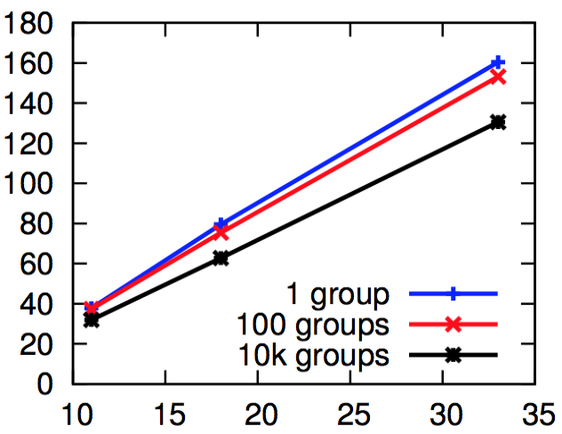
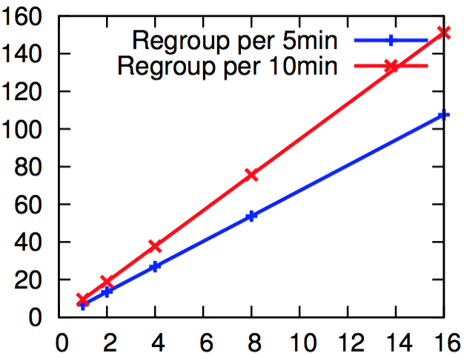
Microbenchmarks
CloudLab instance: 8 cores (2.4 GHz), 64GB RAM
Message per client: 400B
Scalability:
Pytheas throughput is almost horizontally scalable.
Frontend
Backend
# of sessions per sec (K)
Real scale:
30 CloudLab nodes can handle YouTube workload (5B sessions/day) with sub-second feedback delay.
# of sessions per sec (K)
# of instances
# of instances

Slide 24
Conclusion
Motivation: Data-driven approach shows promising QoE improvement.
But prior prediction-based systems have fundamental limitations
This talk:
Right abstraction: Real-time E2 (Real-time exploration exploitation)
Challenge: Respond to geo-distributed clients with fresh data at scale
Solution: Pytheas realizes Real-time E2 in networking contexts with Group-based E2
Improve video QoE over a prediction-based baseline by 30% (mean) and 78% (90th%ile)

